Slide 1
PARAkai springs booking system
Arishay Reddy & Khushal Navle
ISCG6420 IWD S2-2024 ASSIGNMENT 3

Slide 2

TABLE OF CONTENTS
1. Introduction Part 1
1.1. Website Booking system wireframe
1.2. Data Integration
1.3. Booking Validation
2. Introduction Part 2
2.1. Game Wireframe and storyboard
2.2. Game Controls
2.3. Game Mechanics
2.4. Questions and Answers

Slide 3

Introduction
Purpose for the Website?
Notes:
Parakai Springs wants a prototype for their event hosting, and Young Simmer programme, The Target auduience is for event organisers and big family gatherings. So with the use of HTML, CSS, Javas

Slide 4

PART 1 – Booking System
Presented by Arishay Reddy
Notes:
Arishay: I will now talk about the Booking system

Slide 5
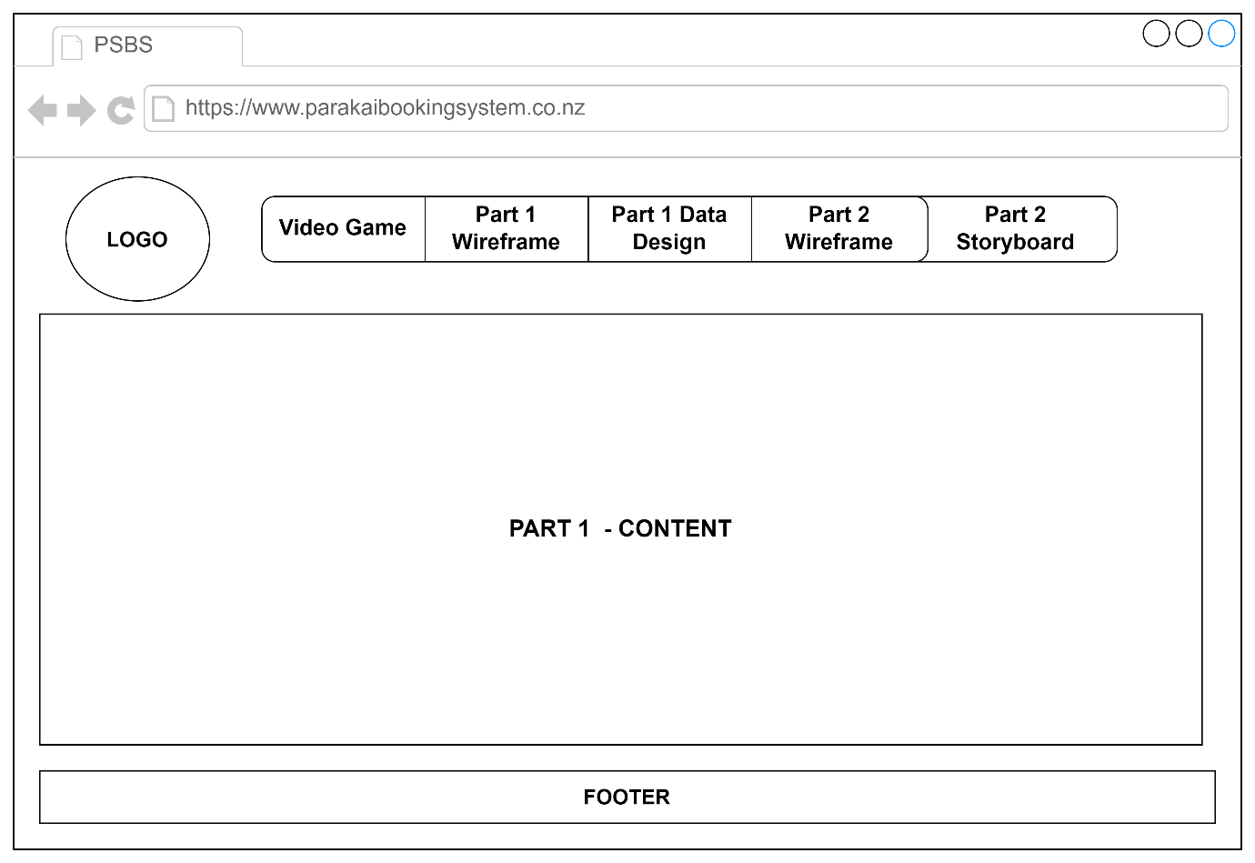
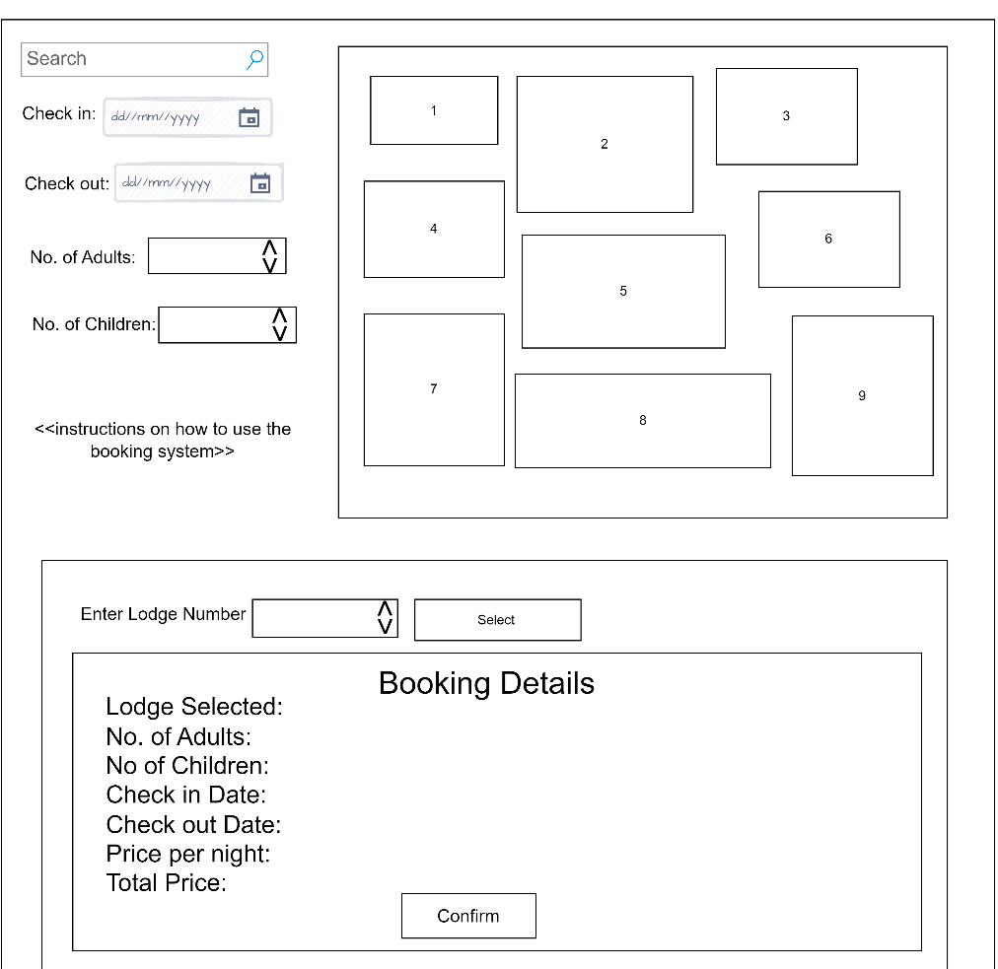
Website Wireframe
How web layout and booking system
Dutcher, 2017
Notes:
Image 1 is the layout of the website; we researched online what principles and rules a website should follow
we found;
Logo; should be placed top left corner of the webpage
Navigation bar; should be placed top of the page to ensure users can easily use the website ands access all pages
Main content; should be in the centre and kept simple as it’s the most important
Footer; bottom of page
Image 2;
Is how to booking summary system works;
It focuses on check in date, check out date, number of attended and I have added a search filter to make it easier for user to find areas based on their need
Once the details have been entered and area selected a booking summary will be displayed;
Which has; area selected, max capacity, check in date, out date, price per day, per night, and attendees

Slide 6
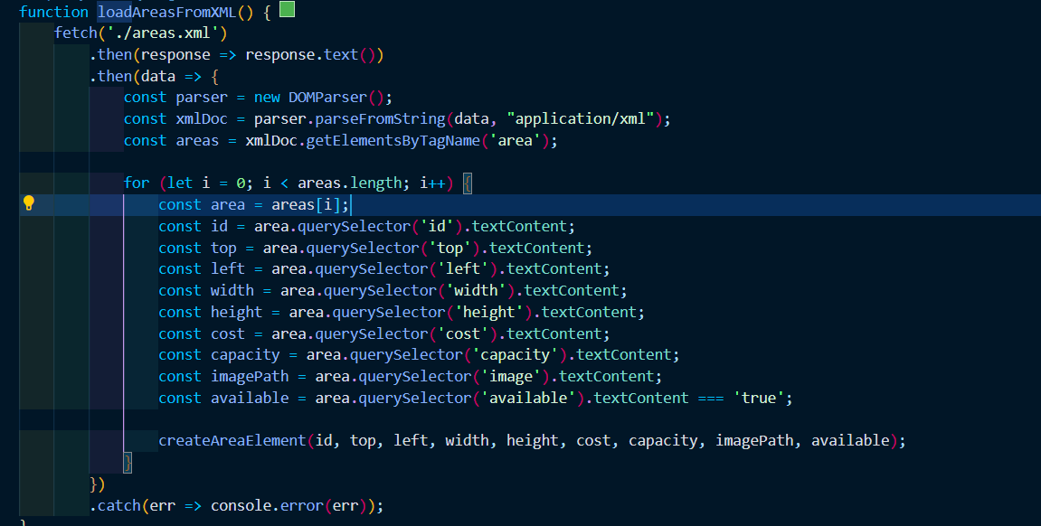
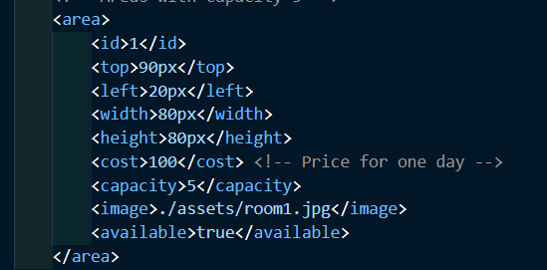
Data Integration with XML
JavaScript
XML
Notes:
How we the data was loaded from xml to javascript was the function LoadAreasFROMXML() reads and parses the xml.
the function uses fetchs to get the xml file. Once it is fetched, its parsed using DOMPARSER which converts the xml data into a format that Javascript can work with.
It then doe a getElements by Tagname(‘area’ ) method which extracts all <area> elements in the xml. Query Selector was used to extract each element (by their tag names) such as area id, area image capacity, and cost.
After the data is gathered, we used a create Area Element function that’s called for each area. It creates a div element which represents the area on the map.

Slide 7
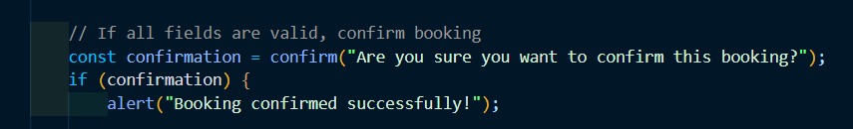
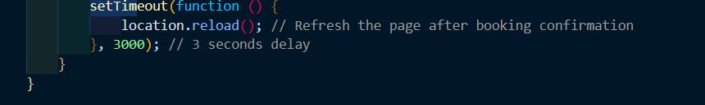
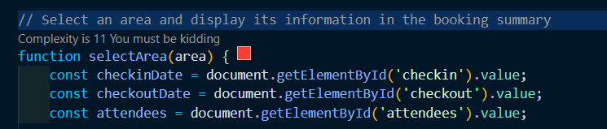
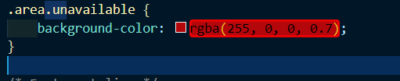
DATA INTEGRATION Booking Summary
Notes:
The xml file has details about each area such as cost, capacity, when the user selects an area, on the map the select Area function is triggered, the function checks if area is available, and gets the data about the area, and the user input such as the dates and attendees and calculates the total cost based on the number of days.
It then updates the booking summary with the details.
When the booking is confirmed the area changes to red to show it has been booked, this happens when the confirm booking function is executed and the confirm booking is clicked. It will check validation of the field and if correct it will book. This shows that the area is unavailable for booking
A setTimeout function is used to tigger the page to reload after 3 seconds which refresh page and turns back to normal.
Once successfully booked, the area div class is updated to dot unavailable (.uanable) which changes the color to red. This allows the user to come back to book more areas if needed.

Slide 8
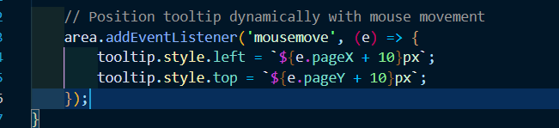
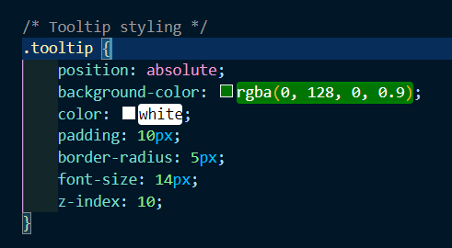
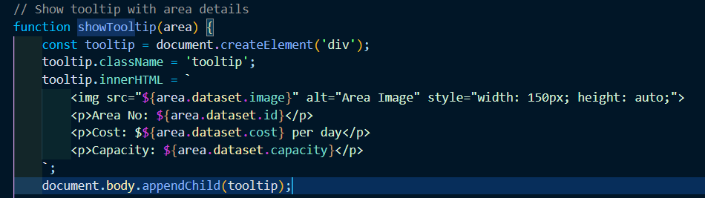
DATA INTEGRATION Map Area
Notes:
A function show tooltip was used to show area details, an event listener was used so as the cursor moves it follows the tool tip.

Slide 9
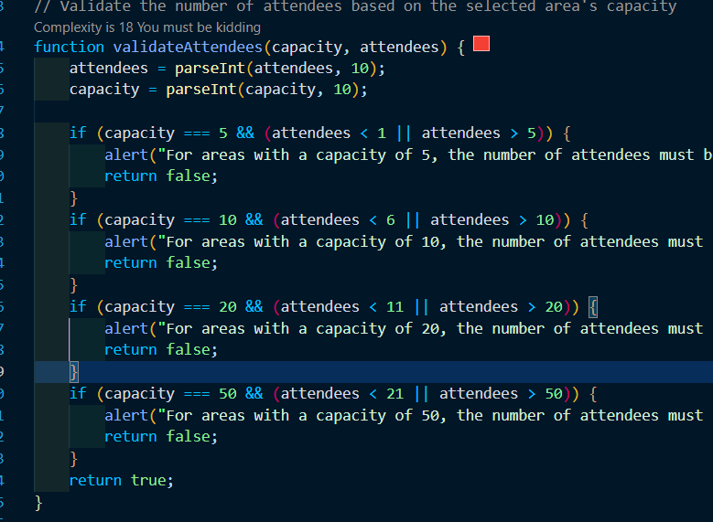
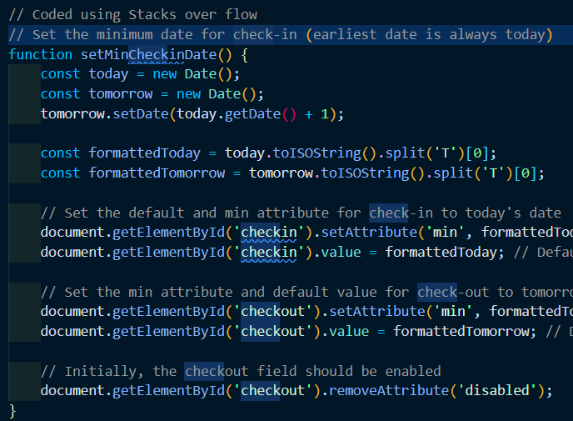
Booking Validation
Notes:
The function validate attendees is called when the number of attendees is updated in the form, it has parameters capacity, and areas.
It converts the capacity and attendees into numbers using the Parse Int. based on area capacity, it checks if the number of attendees is within the range allowed.
If the input doesn’t then it will give an alert message and return false., if it is valid it returns true, and allows the user to continue to book.
A function SetMinCheckindDate and updateCheckoutMinDate is used to when the page loads. The check in date is set as default to todays date and checkout is tommows date. It creates a new date object for today, then adds one day to get tommorows date.

Slide 10
PARt1Live demo

Slide 11

Part 2 - Game
Presented by Khushal Navle

Slide 12

Introduction
Purpose of the game?
Notes:
The purpose of the game is for childs to play a 2d game that will teach them how to use the toys in the pool

Slide 13
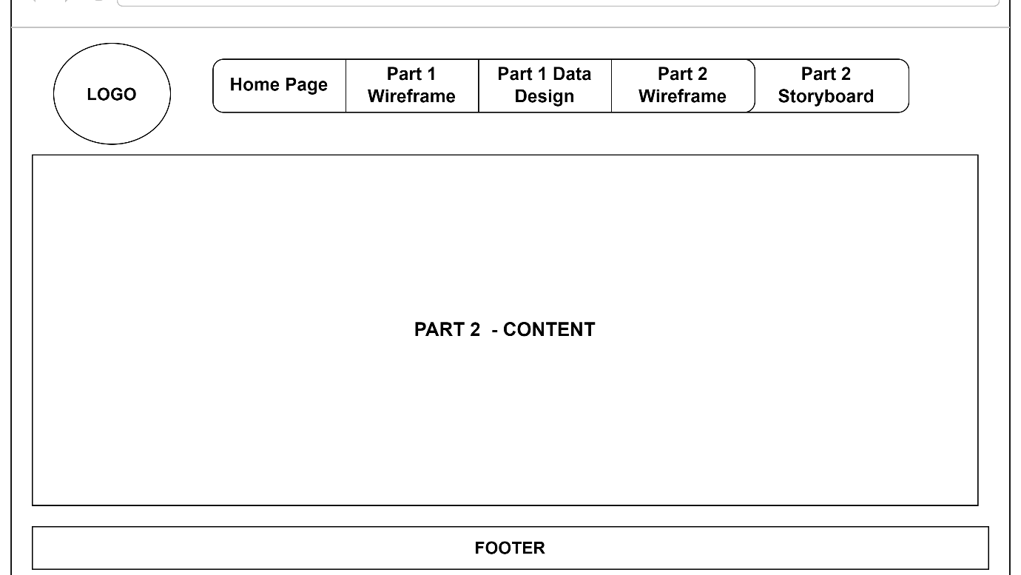
Game Wireframe
How the website would look for the game page
Notes:
The layout is like the website layout, just has the game instead of the booking system, again it was using the research we did to produce the layout.

Slide 14
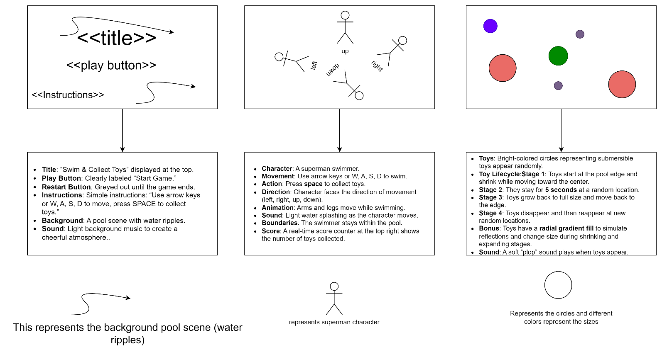
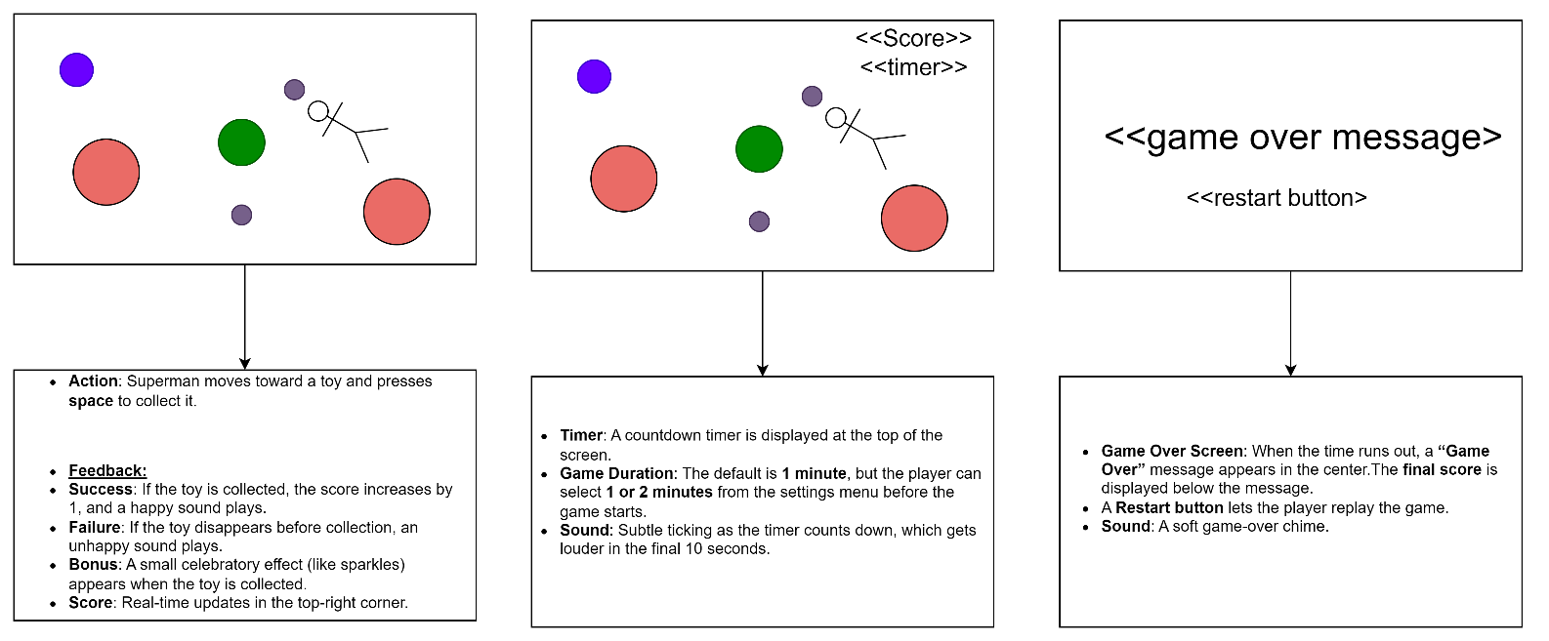
Game Storyboard
Process of gaming being drawn and designed
Notes:
The storyboard was put together to get an idea of how the game will and should look, as you will see in the demo we tried to base it of the storyboard. Because the story board was big was broken it into 2 sets of 3.

Slide 15
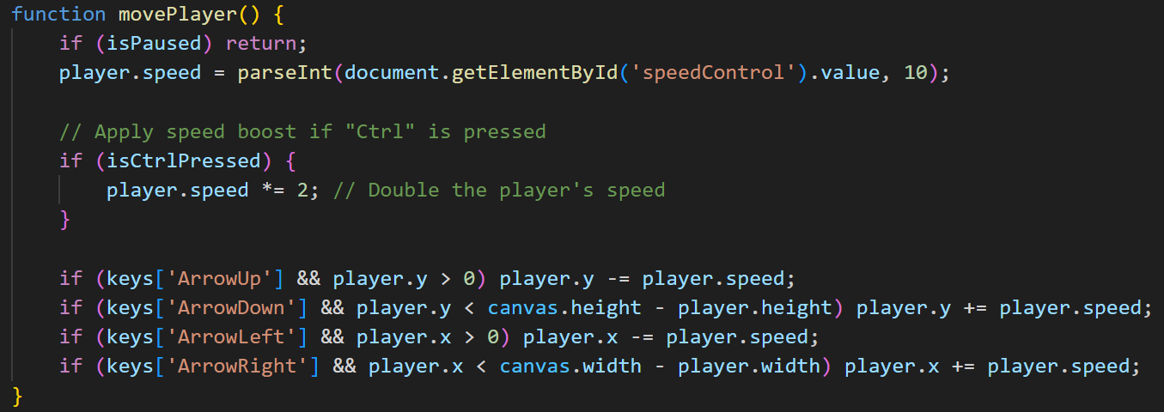
Game Controls
Use of keys

Slide 16
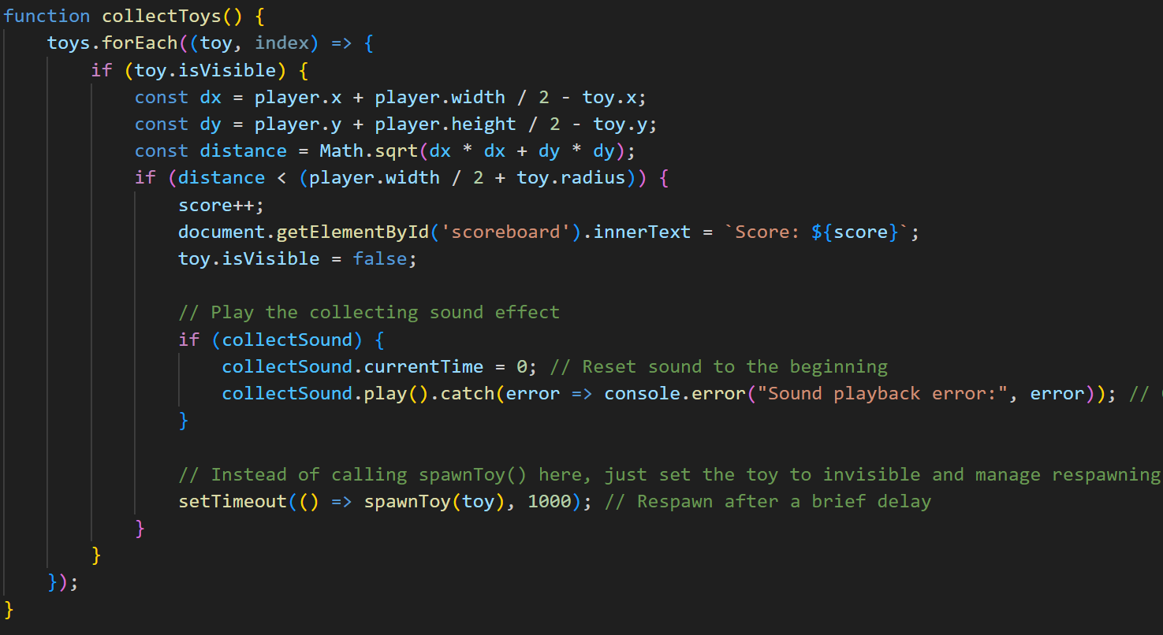
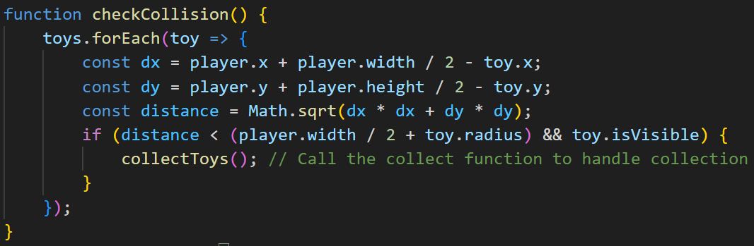
Game Mechanics
How are toys collected? Timing and Scoring,

Slide 17

Part 2 LIVE DEMO
Notes:
Live demo of game now being presented

Slide 18
references
Weekly Exercises
W3 Schools
Stacks overflow
Notes:
These were the tools that we used to complete this project

Slide 19

Questions and Answers
Thank You for listening.

